Slide 1

TEMPLATE 1
https://gsk-test.frontmen.fm/page-content/I8nhe5Cmax
Can we please increase the size of Centrum logo?

Slide 2
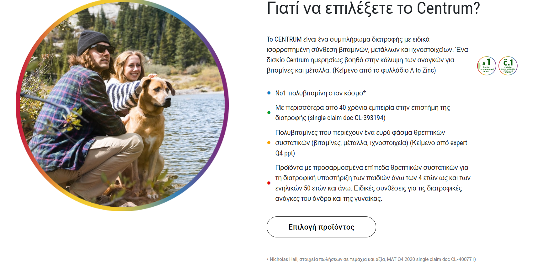
TEMPLATE 1
https://gsk-test.frontmen.fm/page-content/I8nhe5Cmax
The font type seems to be different than the Greek language. Can it be the same?
Remove both circles. No need to have them in GR template
Delete this text
Delete this text
Delete this text
Delete this text
Can the bullet be placed at the 1st sentence of each paragraph?
Delete this text

Slide 3
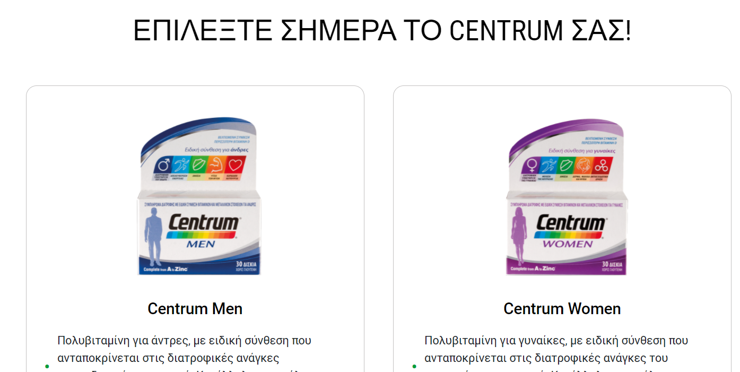
TEMPLATE 1
The font type seems to be different than the Greek language. Can it be the same?
https://gsk-test.frontmen.fm/page-content/I8nhe5Cmax

Slide 4
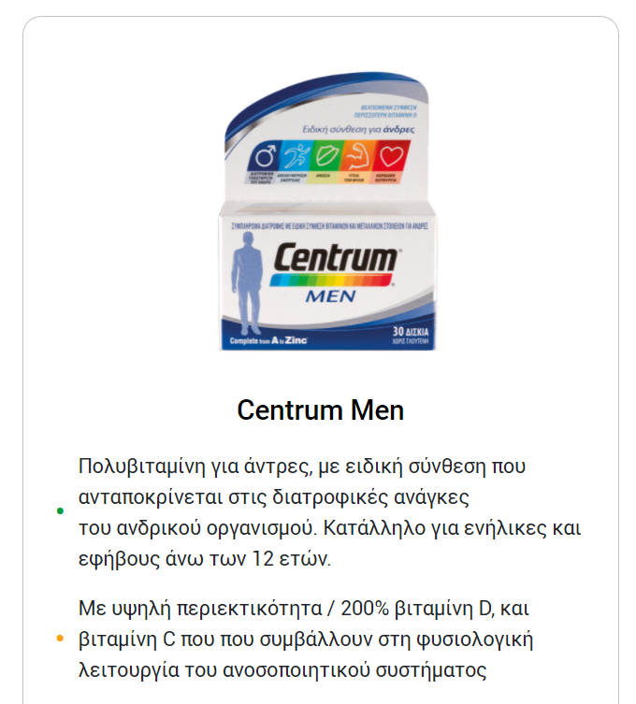

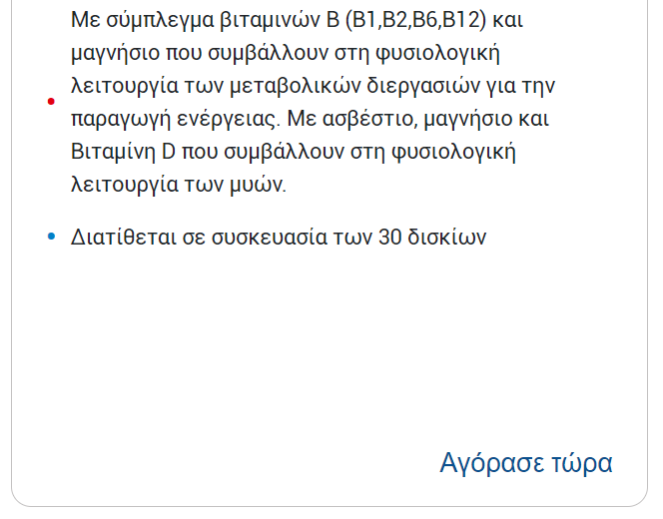

TEMPLATE 1
https://gsk-test.frontmen.fm/page-content/I8nhe5Cmax
The indication (circle) for Adults is missing. Please put it with the text:
Για ενήλικες
Same comment about the bullets: can they be placed at the 1st sentence of each paragraph?
Replace /200% with σε
Delete this word
Leave space after each comma
The underlined text should be put in separate bullet as it is in the English master template
Call to action button Buy Now to be the same as in the other templates (see below screenshot) as it stands out better this way (with the black shape)

Slide 5
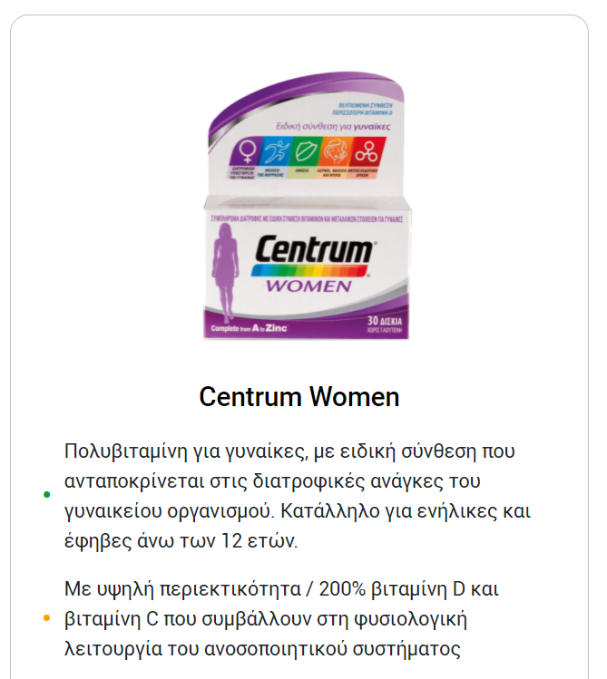
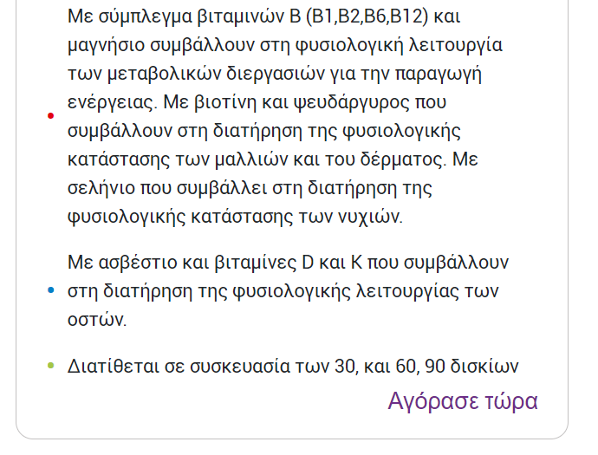
TEMPLATE 1
https://gsk-test.frontmen.fm/page-content/I8nhe5Cmax
The indication (circle) for Adults is missing. Please put it with the text:
Για ενήλικες
Same comment about the bullets: can they be placed at the 1st sentence of each paragraph?
Replace /200% with σε
Leave space after each comma
Rewrite this text as:
μαγνήσιο που συμβάλλουν
The underlined text should be put in separate bullet as it is in the English master template. Rewrite the whole text as follows:
Με βιοτίνη, ψευδάργυρο και σελήνιο που συμβάλλουν στη διατήρηση της φυσιολογικής κατάστασης των μαλλιών, των νυχιών και του δέρματος
Rewrite this text as follows:
30 και 60 δισκίων
Call to action button Buy Now to be the same as in the other templates (see below screenshot) as it stands out better this way (with the black shape)

Slide 6
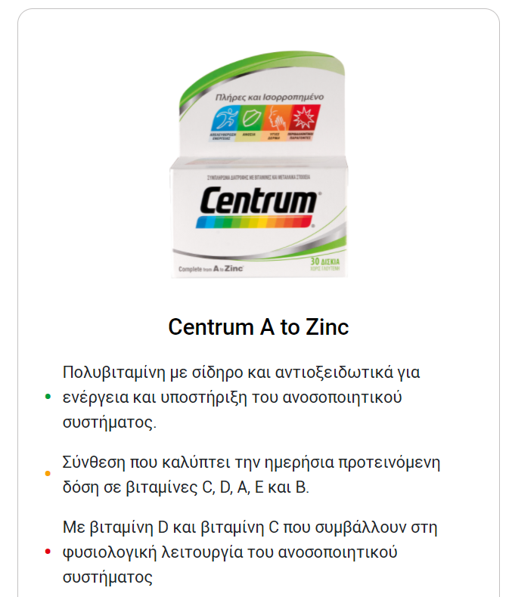
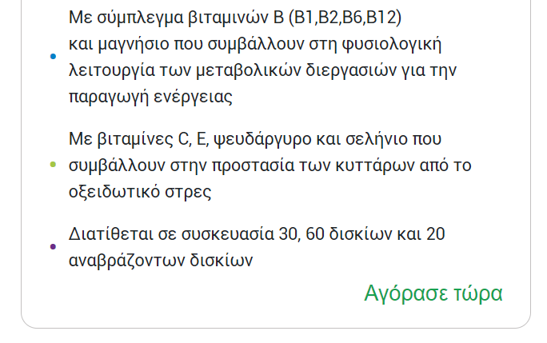
TEMPLATE 1
https://gsk-test.frontmen.fm/page-content/I8nhe5Cmax
The indication (circle) for Adults is missing. Please put it with the text:
Για ενήλικες
Same comment about the bullets: can they be placed at the 1st sentence of each paragraph?
Leave space after each comma
Call to action button Buy Now to be the same as in the other templates (see below screenshot) as it stands out better this way (with the black shape)

Slide 7
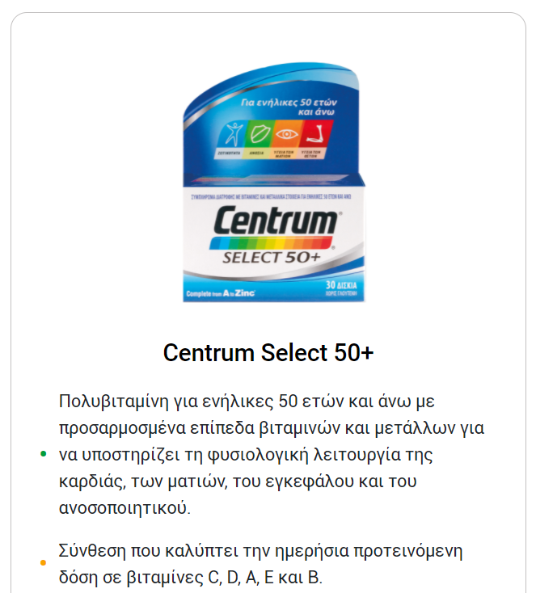

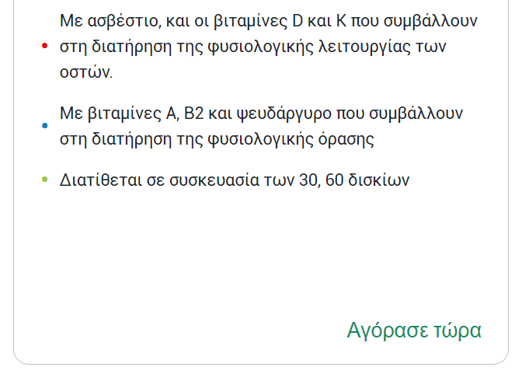
TEMPLATE 1
https://gsk-test.frontmen.fm/page-content/I8nhe5Cmax
The indication (circle) for Adults 50+ is missing. Please put it with the text:
Για ενήλικες 50+ ετών
Can we change the color of the circle to dark blue (as the pack color)?
Same comment about the bullets: can they be placed at the 1st sentence of each paragraph?
Rewrite as follows:
ανοσοποιητικού συστήματος.
Delete this word
Rewrite as follows:
κατάστασης
Rewrite as follows:
30 και 60
Call to action button Buy Now to be the same as in the other templates (see below screenshot) as it stands out better this way (with the black shape)

Slide 8
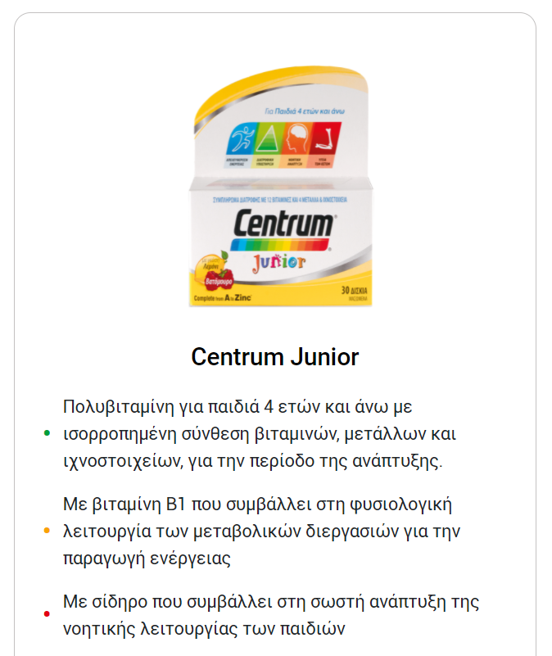

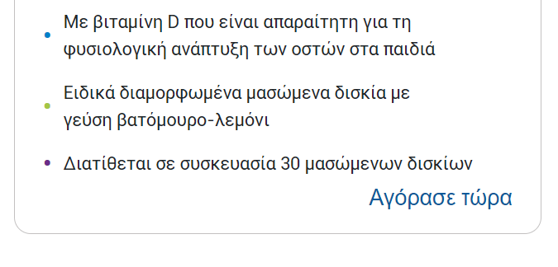
TEMPLATE 1
https://gsk-test.frontmen.fm/page-content/I8nhe5Cmax
The indication (circle) for Kids is missing. Please put it with the text:
Για παιδιά 4+ ετών
Same comment about the bullets: can they be placed at the 1st sentence of each paragraph?
Call to action button Buy Now to be the same as in the other templates (see below screenshot) as it stands out better this way (with the black shape)

Slide 9
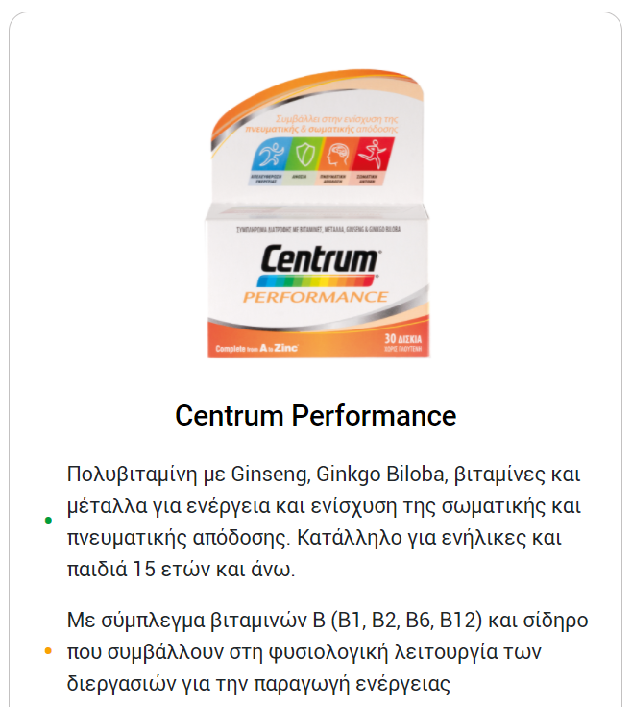
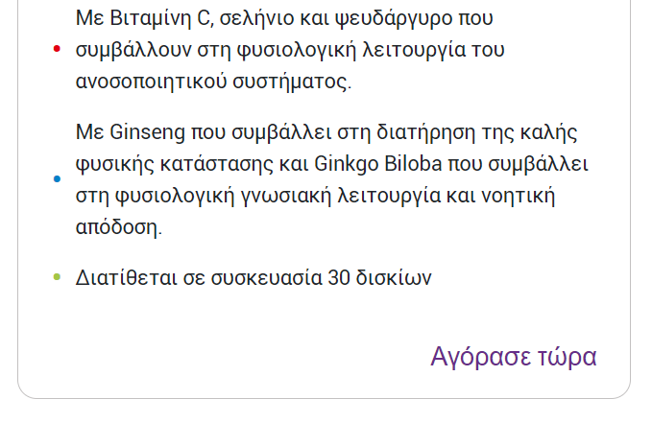
TEMPLATE 1
https://gsk-test.frontmen.fm/page-content/I8nhe5Cmax
The indication (circle) for Adults is missing. Please put it with the text:
Για ενήλικες
Same comment about the bullets: can they be placed at the 1st sentence of each paragraph?
Leave space after each comma
Call to action button Buy Now to be the same as in the other templates (see below screenshot) as it stands out better this way (with the black shape)

Slide 10
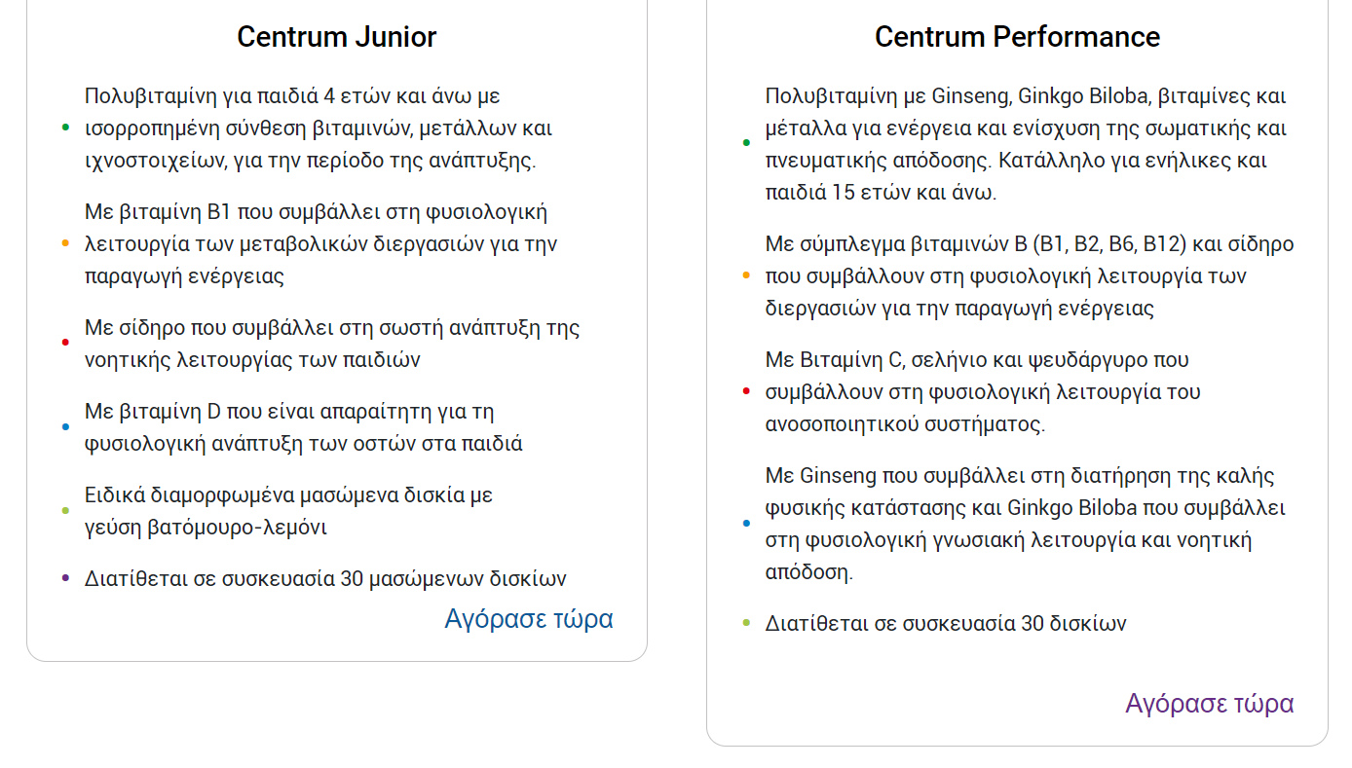
TEMPLATE 1
https://gsk-test.frontmen.fm/page-content/I8nhe5Cmax
Both text boxes to finish at the same level, ie make Junior grey outline bigger to finish at the same level with Performance

Slide 11
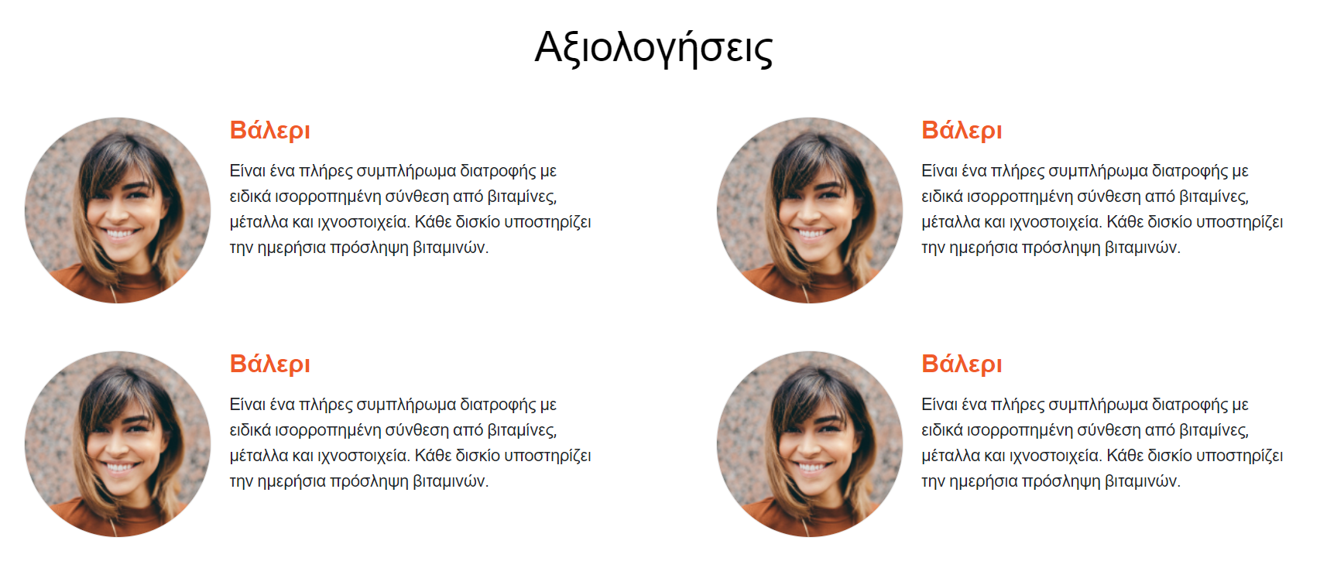
TEMPLATE 1
https://gsk-test.frontmen.fm/page-content/I8nhe5Cmax
The section Reviews to be totally removed, we would like to have this section at all.

Slide 12


TEMPLATE 1
https://gsk-test.frontmen.fm/page-content/I8nhe5Cmax
Since the products are visible at the same page, where is this call to action button (Choose your product) redirecting?
In any case, we would like to use our current key visual (see below screenshot) instead of this picture and text. Is this feasible?

Slide 13
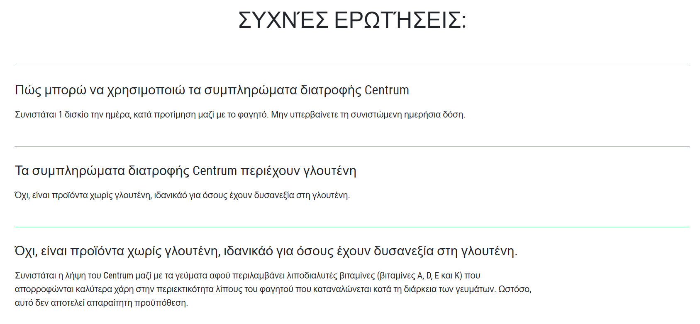
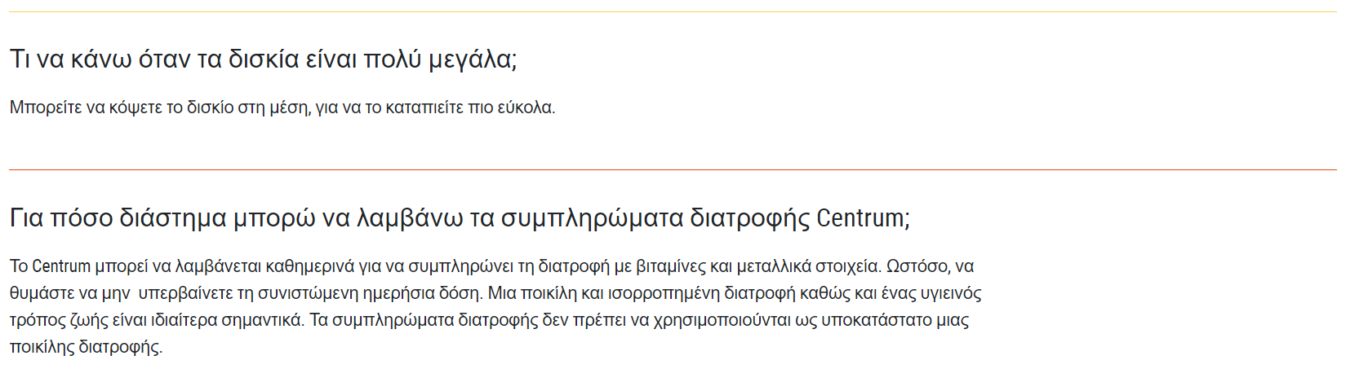
TEMPLATE 1
https://gsk-test.frontmen.fm/page-content/I8nhe5Cmax
Rewrite as follows:
ΣΥΧΝΕΣ ΕΡΩΤΗΣΕΙΣ
Put question mark ; at the end of the sentence, ie Centrum;
Put question mark ; at the end of the sentence, ie γλουτένη;
Rewrite as follows: ιδανικά
All the sentence is wrong. Rewrite as follows:
Ποια είναι η ιδανική ώρα μέσα στην ημέρα για να λαμβάνω τις πολυβιταμίνες Centrum;

Slide 14

TEMPLATE 1
https://gsk-test.frontmen.fm/page-content/I8nhe5Cmax
Disclaimer font size should become bigger as it needs to be readable (at the moment it is not)

Slide 15

TEMPLATE 2
https://gsk-test.frontmen.fm/page-content/sDtF9ziSCU
Can we please increase the size of Centrum logo?

Slide 16

TEMPLATE 2
https://gsk-test.frontmen.fm/page-content/sDtF9ziSCU
The font type seems to be different than the Greek language. Can it be the same?
Remove both circles. No need to have them in GR template
Delete this text
Delete this text
Delete this text
Delete this text
Can the bullet be placed at the 1st sentence of each paragraph?
Delete this text

Slide 17
TEMPLATE 2
The font type seems to be different than the Greek language. Can it be the same?
https://gsk-test.frontmen.fm/page-content/sDtF9ziSCU

Slide 18

TEMPLATE 2
https://gsk-test.frontmen.fm/page-content/sDtF9ziSCU
The indication (circle) for Adults is missing. Please put it with the text:
Για ενήλικες
Same comment about the bullets: can they be placed at the 1st sentence of each paragraph?
Replace /200% with σε
Delete this word
Leave space after each comma
The underlined text should be put in separate bullet as it is in the English master template

Slide 19
TEMPLATE 2
https://gsk-test.frontmen.fm/page-content/sDtF9ziSCU
The indication (circle) for Adults is missing. Please put it with the text:
Για ενήλικες
Same comment about the bullets: can they be placed at the 1st sentence of each paragraph?
Replace /200% with σε
Leave space after each comma
Rewrite this text as:
μαγνήσιο που συμβάλλουν
The underlined text should be put in separate bullet as it is in the English master template. Rewrite the whole text as follows:
Με βιοτίνη, ψευδάργυρο και σελήνιο που συμβάλλουν στη διατήρηση της φυσιολογικής κατάστασης των μαλλιών, των νυχιών και του δέρματος
Rewrite this text as follows:
30 και 60 δισκίων

Slide 20
TEMPLATE 2
https://gsk-test.frontmen.fm/page-content/sDtF9ziSCU
The indication (circle) for Adults is missing. Please put it with the text:
Για ενήλικες
Same comment about the bullets: can they be placed at the 1st sentence of each paragraph?
Leave space after each comma
Call to action button Buy Now to be the same as in the other templates (see below screenshot) as it stands out better this way (with the black shape)

Slide 21
TEMPLATE 2
https://gsk-test.frontmen.fm/page-content/sDtF9ziSCU
The indication (circle) for Adults 50+ is missing. Please put it with the text:
Για ενήλικες 50+ ετών
Can we change the color of the circle to dark blue (as the pack color)?
Same comment about the bullets: can they be placed at the 1st sentence of each paragraph?
Rewrite as follows:
ανοσοποιητικού συστήματος.
Delete this word
Rewrite as follows:
κατάστασης
Rewrite as follows:
30 και 60

Slide 22
TEMPLATE 2
https://gsk-test.frontmen.fm/page-content/sDtF9ziSCU
The indication (circle) for Kids is missing. Please put it with the text:
Για παιδιά 4+ ετών
Same comment about the bullets: can they be placed at the 1st sentence of each paragraph?

Slide 23
TEMPLATE 2
https://gsk-test.frontmen.fm/page-content/sDtF9ziSCU
The indication (circle) for Adults is missing. Please put it with the text:
Για ενήλικες
Same comment about the bullets: can they be placed at the 1st sentence of each paragraph?
Leave space after each comma

Slide 24
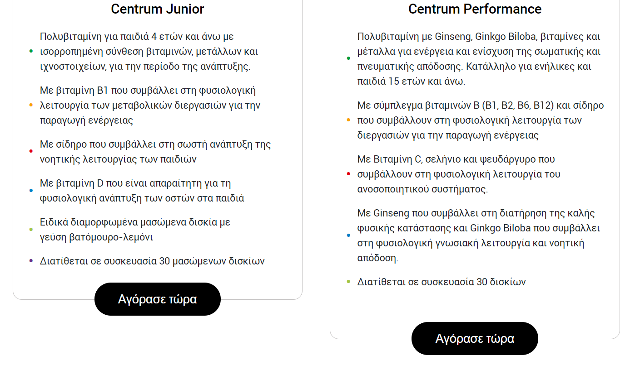
TEMPLATE 2
https://gsk-test.frontmen.fm/page-content/sDtF9ziSCU
Both text boxes to finish at the same level, ie make Junior grey outline bigger to finish at the same level with Performance

Slide 25
TEMPLATE 2
https://gsk-test.frontmen.fm/page-content/sDtF9ziSCU
The section Reviews to be totally removed, we would like to have this section at all.

Slide 26

TEMPLATE 2
https://gsk-test.frontmen.fm/page-content/sDtF9ziSCU
Since the products are visible at the same page, where is this call to action button (Choose your product) redirecting?
In any case, we would like to use our current key visual (see below screenshot) instead of this picture and text. Is this feasible?

Slide 27

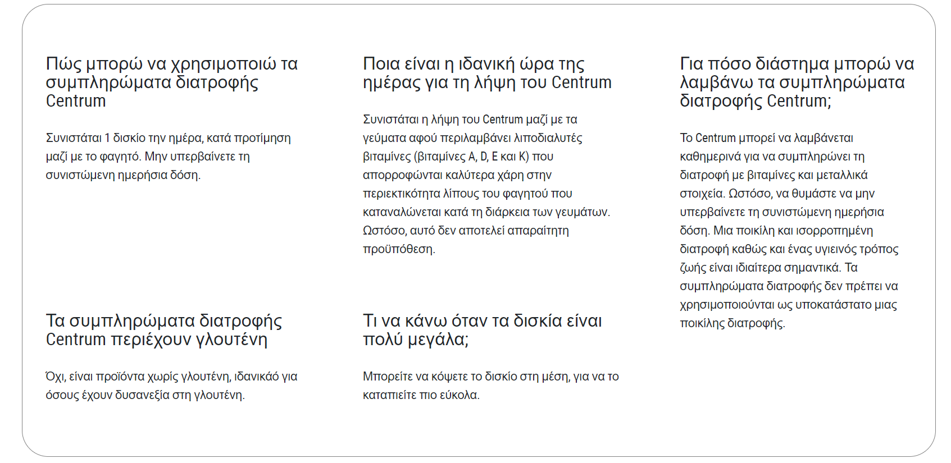
TEMPLATE 2
https://gsk-test.frontmen.fm/page-content/sDtF9ziSCU
Rewrite as follows:
ΣΥΧΝΕΣ ΕΡΩΤΗΣΕΙΣ
Rewrite as follows:
Ποια είναι η ιδανική ώρα μέσα στην ημέρα για να λαμβάνω τις πολυβιταμίνες Centrum;
Put question mark ; at the end of the sentence, ie Centrum;
Put question mark ; at the end of the sentence, ie γλουτένη;
Rewrite as follows: ιδανικά

Slide 28
TEMPLATE 2
https://gsk-test.frontmen.fm/page-content/sDtF9ziSCU
Disclaimer font size should become bigger as it needs to be readable (at the moment it is not)

Slide 29

TEMPLATE 3
https://gsk-test.frontmen.fm/page-content/5IPlBZzrwG
Can we please increase the size of Centrum logo?

Slide 30

TEMPLATE 3
https://gsk-test.frontmen.fm/page-content/5IPlBZzrwG
The font type seems to be different than the Greek language. Can it be the same?
Remove both circles. No need to have them in GR template
Delete this text
Delete this text
Delete this text
Delete this text
Can the bullet be placed at the 1st sentence of each paragraph?
Delete this text

Slide 31
TEMPLATE 3
The font type seems to be different than the Greek language. Can it be the same?
https://gsk-test.frontmen.fm/page-content/5IPlBZzrwG

Slide 32
TEMPLATE 3
https://gsk-test.frontmen.fm/page-content/5IPlBZzrwG
The indication (circle) for Adults is missing. Please put it with the text:
Για ενήλικες
Same comment about the bullets: can they be placed at the 1st sentence of each paragraph?
Replace /200% with σε
Delete this word
Leave space after each comma
The underlined text should be put in separate bullet as it is in the English master template

Slide 33
TEMPLATE 3
https://gsk-test.frontmen.fm/page-content/5IPlBZzrwG
The indication (circle) for Adults is missing. Please put it with the text:
Για ενήλικες
Same comment about the bullets: can they be placed at the 1st sentence of each paragraph?
Replace /200% with σε
Leave space after each comma
Rewrite this text as:
μαγνήσιο που συμβάλλουν
The underlined text should be put in separate bullet as it is in the English master template. Rewrite the whole text as follows:
Με βιοτίνη, ψευδάργυρο και σελήνιο που συμβάλλουν στη διατήρηση της φυσιολογικής κατάστασης των μαλλιών, των νυχιών και του δέρματος
Rewrite this text as follows:
30 και 60 δισκίων

Slide 34
TEMPLATE 3
https://gsk-test.frontmen.fm/page-content/5IPlBZzrwG
The indication (circle) for Adults is missing. Please put it with the text:
Για ενήλικες
Same comment about the bullets: can they be placed at the 1st sentence of each paragraph?
Leave space after each comma
Call to action button Buy Now to be the same as in the other templates (see below screenshot) as it stands out better this way (with the black shape)

Slide 35
TEMPLATE 3
https://gsk-test.frontmen.fm/page-content/5IPlBZzrwG
The indication (circle) for Adults 50+ is missing. Please put it with the text:
Για ενήλικες 50+ ετών
Can we change the color of the circle to dark blue (as the pack color)?
Same comment about the bullets: can they be placed at the 1st sentence of each paragraph?
Rewrite as follows:
ανοσοποιητικού συστήματος.
Delete this word
Rewrite as follows:
κατάστασης
Rewrite as follows:
30 και 60

Slide 36
TEMPLATE 3
https://gsk-test.frontmen.fm/page-content/5IPlBZzrwG
The indication (circle) for Kids is missing. Please put it with the text:
Για παιδιά 4+ ετών
Same comment about the bullets: can they be placed at the 1st sentence of each paragraph?

Slide 37
TEMPLATE 3
https://gsk-test.frontmen.fm/page-content/5IPlBZzrwG
The indication (circle) for Adults is missing. Please put it with the text:
Για ενήλικες
Same comment about the bullets: can they be placed at the 1st sentence of each paragraph?
Leave space after each comma

Slide 38
TEMPLATE 3
https://gsk-test.frontmen.fm/page-content/5IPlBZzrwG
Both text boxes to finish at the same level, ie make Junior grey outline bigger to finish at the same level with Performance

Slide 39
TEMPLATE 3
https://gsk-test.frontmen.fm/page-content/5IPlBZzrwG
The section Reviews to be totally removed, we would like to have this section at all.

Slide 40

TEMPLATE 3
https://gsk-test.frontmen.fm/page-content/5IPlBZzrwG
Since the products are visible at the same page, where is this call to action button (Choose your product) redirecting?
In any case, we would like to use our current key visual (see below screenshot) instead of this picture and text. Is this feasible?

Slide 41

TEMPLATE 3
https://gsk-test.frontmen.fm/page-content/5IPlBZzrwG
Rewrite as follows:
ΣΥΧΝΕΣ ΕΡΩΤΗΣΕΙΣ
Please rewrite as follows:
Πώς μπορώ να χρησιμοποιώ τα συμπληρώματα διατροφής Centrum;
Put question mark ; at the end of the sentence, ie γλουτένη;
Rewrite as follows: ιδανικά
All the sentence is wrong. Rewrite as follows:
Ποια είναι η ιδανική ώρα μέσα στην ημέρα για να λαμβάνω τις πολυβιταμίνες Centrum;

Slide 42
TEMPLATE 3
https://gsk-test.frontmen.fm/page-content/5IPlBZzrwG
Disclaimer font size should become bigger as it needs to be readable (at the moment it is not)

